Slide 1
English Literature

Slide 2
Chapter goals
To be familiar with some great writers and their works
To know a writer and his (her) works in depth and can make comment on him(her)

Slide 3
Old English literature
Middle English literature
Elizabeth’s England#11. Elizabeth’s England
17th Century
18th Century#43. Writers
The Romantic Period#47. The Romantic Period
Victorian Literature#61. Vanity Fair
20th Century

Slide 4
Writer | Works | Genre | Content
Old English Literature
 | Beowulf
Under King Alfred’s direction
Middle English Literature
Geoffrey Chaucer (1340?-1400)
The 16th Century
Thomas More (1478-1535)
Sir Thomas Wyatt (1503-42)
Earl of Surrey (1517-47)
William Shakespeare(1564-1616)
 | Antony and Cleopatra (1607)

Slide 5
Writer | Works | Genre | Content
Old English Literature
 | Beowulf#15. Old English Literature | Anglo-Saxon epic poem | The battles of Beowulf from Sweden to aid Danish King to fight against sea monsters
Under King Alfred’s direction | The Anglo-Saxon Chronicle | The chronicle | It gives the events of English history from the Roman invasion of Britain in 54 B.C. to the middle of the 12th century
Middle English Literature
Geoffrey Chaucer (1340?-1400) | The Canterbury Tales (1387?) |  | It is a collection of stories told with superb poetic craft and it gives a cross-section of medieval life.
The 16th Century
Thomas More (1478-1535) | Utopia (1516) | Utopian | It tells of a journey to an imaginary island named Utopia, where an ideal form of society exists.
Sir Thomas Wyatt (1503-42) |  | Sonnet, a 14-line poem
Earl of Surrey (1517-47)
William Shakespeare(1564-1616) |  | Tragedies
 |  | Comedy
 | Richard III (1595) | Chronicle Plays
 | Richard II (1595)
 | Henry IV (1597-98) part I and II
 | HenryV （1599）
 | Julius Caesar (1599)
 | Antony and Cleopatra (1607)

Slide 6
The 16th Century
Thomas More (1478-1535) | Utopia (1516) | Utopian | It tells of a journey to an imaginary island named Utopia, where an ideal form of society exists.
Sir Thomas Wyatt (1503-42) |  | Sonnet, a 14-line poem
Earl of Surrey (1517-47)

Slide 7
William Shakespeare(1564-1616) | Romeo and Juliet (1595) | Tragedies
 | Hamlet (1602)
 | Othello (1604)
 | King Lear (1606)
 | Macbeth (1606)
 | The Taming of the Shrew (1596) | Comedies
 | A Midsummer Night’s Dream(1596)
 | As You Like it (1599)
 | Twelfth Night (1600)
 | The Tempest (1611)
 | Richard III (1595) | Chronicle Plays

Slide 8
Old English Literature
English literature begins around the 8th century. The Anglo-Saxon epic poem Beowulf marked the Beginning of English literature.

Slide 9
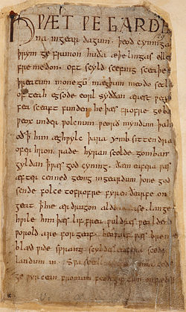
Author(s) Unknown
Language West Saxon
Date its story around the 6th century, and is written down sometime in the 10th century
Genre epic poem
Subject The poem tells how Beowulf comes from Sweden to aid Danish King to fight against sea monsters

Slide 10
The roots of English literature lie deep in the tales of Denmark and other Scandinavian countries.
The foundation stone of English history is the Anglo-Saxon Chronicle. It was compiled under the direction of King Alfred. The Chronicle gives the events of English history from the Roman invasion of Britain in 54 B.C. to the middle of the 12th century.

Slide 11
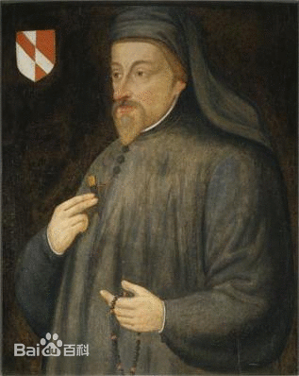
Middle English Literature
Geoffrey Chaucer(1340?-1400) was the greatest figure in Middle English literature. His masterpiece was The Canterbury Tales (1387?).

Slide 12
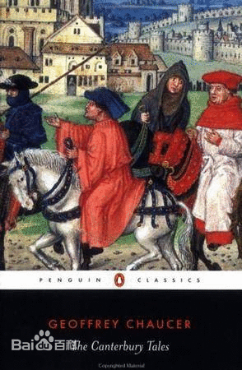
The Canterbury Tales is the most important work in Middle English Literature. It is a collection of stories told with superb poetic craft and it gives a cross-section of medieval life.

Slide 13
16th Century
Sir Thomas More ( 1478-1535) wrote a remarkable book, Utopia (1516). It tells of a journey to an imaginary island named Utopia, where an ideal form of society existed.

Slide 14
Elizabeth’s England
Under Elizabeth’s administration, social order and political stability were maintained; national economy was greatly developed; foreign trade and markets were vastly expanded; the nationalistic consciousness became firmly established; the people’s life progressed by gigantic leaps; and English literature reached the very highest point of its development.

Slide 15
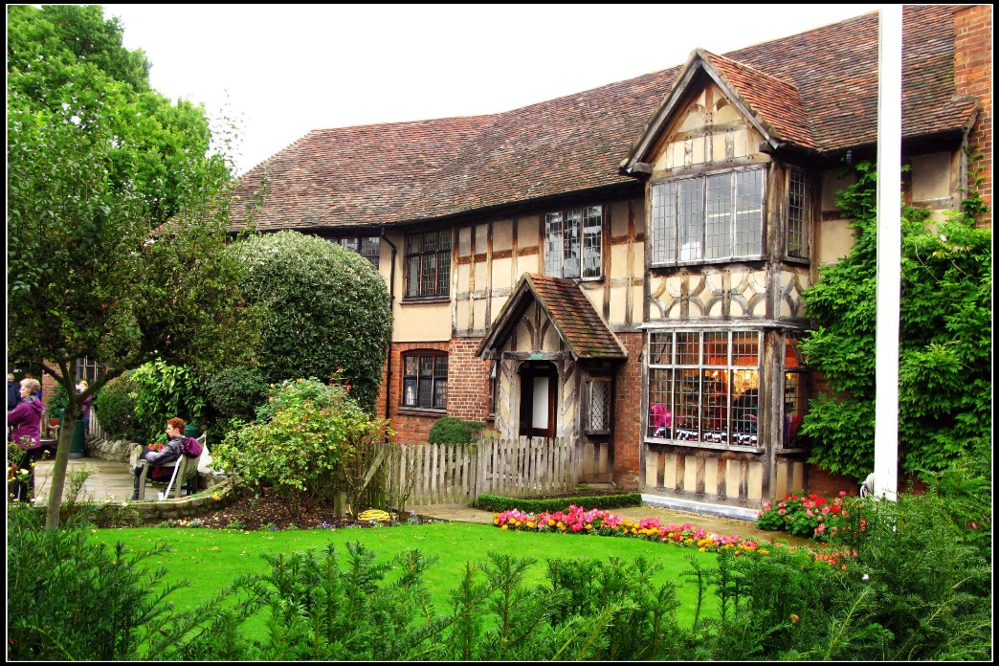
William Shakespeare(1564-1616) was born into a merchant’s family in Stratford-on-Avon.

Slide 16
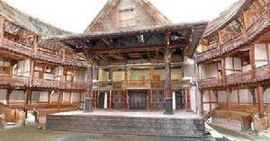
He was an English dramatist and poet in the Elizabethan age. He is generally regarded as the greatest playwright in English literature.

Slide 17
His plays fall into three categories: tragedy, such as Hamlet (1602), Romeo and Juliet (1595), Othello (1604), King Lear (1606) and Macbeth (1606); comedy, such as The Taming of the Shrew (1596), A Midsummer Night’s Dream (1596), As You Like It (1599), Twelfth Night (1600), and The Tempest (1611); and chronicle plays, such as Richard III (1595), Richard II (1595), Henry IV (1597-98), and Henry V (1599).

Slide 18
Hamlet, the prince of Denmark, was in a mood of world-weariness occasioned by his father’s recent death and by his mother’s hasty remarriage with Claudius, his father’s brother. His father’s ghost informed Hamlet that Claudius has murdered his father and then taken over both his father’s throne and widow. Hamlet is urged by the ghost to seek revenge for his father’s “foul and most unnatural murder”. But he is so speculative, so questioning, and so contemplative.

Slide 19
Othello is a courageous man of action and wins the love of a young, beautiful, aristocratic lady, Desdemona. But he thus puts himself in peril. Iago is one of Othello’s military subordinates with vile natures. Iago bears a strong grudge against Othello for it is Cassio that is promoted. Iago tries to insinuate into Othello’s mind the suspicion, mounting by degrees to certainty, that Cassio and Desdemona are conducting a secret love affair. Othello falls into Iago’s trap and consequently murders her, which leads to his own final doom.

Slide 20
An impoverished young Venetion, Bassanio, asks his good friend, Antonio, for a loan so that he might gain in marriage the hand of Portia, a rich and beautiful heiress of Belmont. For Antonio’s money is all invested in mercantile expedition, he has to borrow money from the Jewish usurer, Shylock. Shylock has made a strange bond that requires Antonio to surrender a pound of his flesh if he fails to repay him within a certain period of time. Now that Antonio’s ships have all been lost, Shylock asks for a pound of flesh. Portia disguises herself as a young lawyer to judge the case. When Shylock refuses to show his mercy and insisted on the letter of the law, Portia lets him to have it: he may take his pound of flesh, but a single drop of blood means his lands and goods will be confiscated.

Slide 21
A Middlesummer Night’s Dream
Two pairs of lovers Hermia, a young lady who loves Lysander, is ordered by her father to marry Demetrius; and Demetrius is loved by Hermia’s friend Helena. When Hermia and Lysander flee into the woods in order to escape “the sharp Athenian law”, the other two have also followed into the woods. Thus, each has experienced a transforming vision and each has got a satisfactory solution of his problem with the enchanted power of the sympathetic fairies.

Slide 22
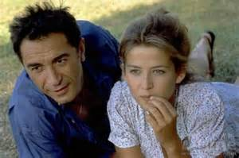
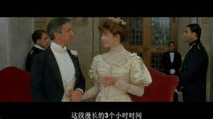
King Theseus and Hippolyta as the background

Slide 23
Hermia, Helena, Lysander and Demetrius and the enchanting power of magical juice
Hermia Lysander
Demetrius
Helena

Slide 24
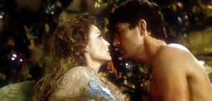
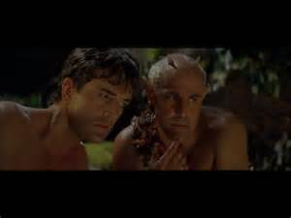
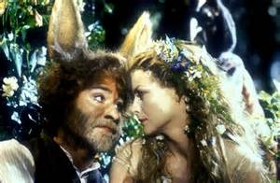
The enchanting power of magical juice: Puck and King Oberon, Queen Titania and the actor, Lysander and Helena

Slide 25
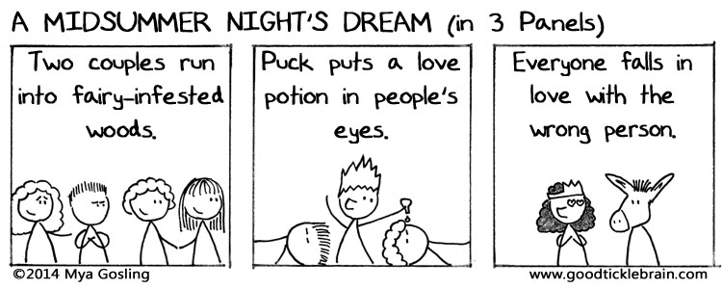

Slide 26

The artistic features of Shakespeare’s plays
His themes of progressive significance: humanistic ideas)
His profound insight into the social issues (feudal tyranny, anti-natural character of marriage, inequality, the corrupting influence of gold and money, ferocious struggle for power…)
Good at character-portrayal
Well-organized: three or four threads running through the story
His language

Slide 27
The course of true love never did run smooth.
I mean, that my heart onto yours is knit.
The will of man is by his reason sway’d.
And so should I, pierced through the heart with your stern cruelty.
Wherein it doth impair the seeing sense, It pays the hearing double recompense.

Slide 28
The 17th Century
 | King James Bible
Francis Bacon (1561-1626)
John Milton (1608-74) |  | Epic
John Bunyan (1628-88)

Slide 29
The 17th Century
 | King James Bible |  | It exerted a great influence on style and standards of taste in English
Francis Bacon (1561-1626) | Essays
John Milton (1608-74) | Paradise Lost (1667), Paradise Regained (1671) | Epic
John Bunyan (1628-88) | The Pilgrim’s Progress |  | Christian, the pilgrim, flees from the City of Destruction. He encounters many difficulties, dangers and temptations in such places as the Slough of Despond and Vanity Fair. He meets such persons as Faithful and Good-will.

Slide 30
17th Century
The late Elizabethans are also Jacobeans, which comes from the Latin form of the name of King James I, Jacobus.
The King James Bible was the translation of the Holy Scripture done in the year of 1611 under the order of King James I. Its language reached the peak of purity and beauty. For many generations it exerted a greater influence on style and standards of taste than any other single work in English.

Slide 31
The most widely read work of Francis Bacon(1561-1626) is the Essays.
Paradise Lost, Paradise Regained and Samson Agonistes were the three masterpieces of John Milton(1608-74), among which Paradise lost is held as the greatest.
The trio of English poetry giants are Geoffrey Chaucer, William Shakespeare and John Milton.
John Bunyan’s (1628-88) most famous work was Pilgrim’s Progress.

Slide 32
The 18th Century (great political disturbance)
Johnathan Swift (1667-1745)
Alexander Pope (1688-1744)
Samuel Johnson and James Boswell
Edmund Burke
Robert Burns (1759-96)
William Blake (1757-1827)
Daniel Defoe (1660-1731)

Slide 33
The 18th Century (great political disturbance)
Johnathan Swift (1667-1745) | Gulliver’s Travels (1726) |  | The fanciful account of four voyages. It touches every vice, folly, and mere weakness of mankind.
Alexander Pope (1688-1744)
Samuel Johnson and James Boswell
Edmund Burke
Robert Burns (1759-96) | Auld Lang Syne
William Blake (1757-1827) | Songs of Experience
Daniel Defoe (1660-1731) | Robinson Crusoe(1719) |  | A tale of shipwreck and solitary survival

Slide 34
18th Century
England became a constitutional monarchy and the state power passed from the king gradually to the Parliament and the cabinet ministers.
It provided the essential conditions for the rising of industrial Revolution.

Slide 35
Changes enriched the bourgeoisie and the aristocracy who ruled the country but brought great miseries to the majority of the people in the commonwealth.1776
The rapid growth of the bourgeois middle class became the backbone and they stressed the virtues of self-discipline, thrift and hard word.
It is an Age of Enlightenment or the Age of Reason. It celebrated reason (rationality), equality, science and human beings’ ability to perfect themselves and their society.

Slide 36
Writers
The novel was the literary form that began to develop during the 18th century.
Jonathan Swift (1667-1745) was a great satirical writer in the 18th century whose name was linked with Gulliver’s Travels. (refer to p123)

Slide 37
Robert Burns (1759-96) was the much-loved poet produced by Scotland in the 18th century.
William Blake (1757-1827) most famous poem collection was called Songs of Experience.
Daniel Defoe’s (1660?-1731) best known work was Robinson Crusoe, the most famous tale of shipwreck and solitary survival in all literature.

Slide 38
 | The Romantic Period (more concerned with imagination and feeling than with the power of reason)
William Wordsworth (1770-1859) | Lyrical Ballads (1798, with Samuel Taylor Coleridge) |  | Romantic poetry’s Declaration of Independence
 | The Prelude (My Heart Leaps Up When I Behold, I Wandered Lonely as a Cloud (or Daffodils))
Samuel Taylor Coleridge (1772-1834)
George Gordon Byron (1788-1824) | Don Juan (1819-24)
 | She Walks in Beauty
John Keats (1795-1821) | Ode on a Grecian Urn
 | Ode to a Nightingale
Percy Bysshe Shelley (1792-1822) | Ode to the West Wind
 | To a Skylark
 | Prometheus Unbound (1820)
Sir Walter Scott (1771-1832) | The Lay of the Last Minstrel (1805)
 | The Lady of the Lake (1810)
 | Ivanhoe (1820)

Slide 39
George Gordon Byron (1788-1824) | Don Juan (1819-24)
 | She Walks in Beauty
John Keats (1795-1821) | Ode on a Grecian Urn
 | Ode to a Nightingale
Percy Bysshe Shelley (1792-1822) | Ode to the West Wind
 | To a Skylark
 | Prometheus Unbound (1820)

Slide 40
Sir Walter Scott (1771-1832) | The Lay of the Last Minstrel (1805)
 | The Lady of the Lake (1810)
 | Ivanhoe (1820)

Slide 41
The Romantic Period
Roughly the first third of the 19th century made up English literature’s romantic period.
Romantic writers were more concerned with imagination and feeling than with the power of reason.
Blake and Burns had shown signs of romanticism. William Wordsworth and Samuel T. Coleridge proclaimed the Declaration of Independence of romantic poetry. Byron, Keats and Shelley brought the romantic movement to its height.

Slide 42

William Wordsworth’s (1770-1850)
To the Cuckoo
O blithe new-comer! I have heard,
I hear thee and rejoice.
O Cuckoo! shall I call thee Bird,
Or but a wandering Voice?
While I am lying on the grass
Thy twofold shout I hear;
From hill to hill it seems to pass
At once far off, and near.
Though babbling only to the Vale,
Of sunshine and of flowers,
Thou bringest unto me a tale
Of visionary hours.
Thrice welcome, darling of the Spring!
Even ye thou art to me
No bird, but an invisible thing,
A voice a mystery;
The same whom in my schoolboy days
I listened to; that Cry
Which made me look a thousand ways
In bush, and tree, and sky.
To seek thee did I often rove
Through woods and on the green;
And thou wert still a hope, a love;
Still longed for, never seen.
And I can listen to thee yet;
Can lie upon the plain
And listen, till I do beget
That golden time again.
O blessed Bird! the earth we pace
Again appears to be
An unsubstantial, faery place;
That is fit home for thee!

Slide 43
致布谷鸟 威廉•华兹华斯
啊，快乐的新客！
听到你啭鸣，我满怀喜悦;
啊，布谷，是否称你为鸟或为妙音，回荡清越？
当我躺在草地上，
听到你的二重唱：
似从这山传到那山，
似在近旁，又在远方
你的歌声在山谷回荡，
伴着繁华和阳光；
你还把我带到
追忆往事的幻想。
我再三地欢迎
你是阳春的先行。
在我眼中，你可不是鸟，
而是无形的神奇之音。
想当年我还是小学生，
曾倾听同样的鸣声；
我千方百计寻找，
从天上到丛林。
我时常漫游，为了找你，
踩着草地，穿过密林；
如今仍在期待，虽不眼见
你仍是希望，是恋情。
此刻我躺在平原，
你的歌声仍能听见。
我专心谛听，
直到召回金色的童年。
我们栖息的大地
又显得空灵而神奇；
这是你安家的福地，
啊， 快乐的鸟儿，祝福你！

Slide 44
Worshipper of nature who advocates a return to nature
The direct experience of the senses is the source of poems.
He is aware of his own sublime communion with all things, nature becomes an inspiring force of rapture, a power that reveals the working of the soul.

Slide 45
Representative of his works: the long autobiographical poem “The Prelude”, “Lines Composed a Few Miles Above Tintern Abbey”, short poems “My Heart Leaps Up When I Behold”, “I Wondered Lonely as a Cloud”(Daffodils),…

Slide 46
S. T. Coleridge co-author of “Lyrical Ballads” which had been called romantic poetry’s Declaration of Indendence
George Gordon, Lord Byron (1778-1824): Don Juan (1819-24
John Keats (1795-1821) was superb at pictorial poetry --- painting a picture with words. His poems include “Ode on a Grecian Urn”, “Ode to a Nightingale”.
Percy Bysshe Shelly’s (1792-1822) writing has a wide range. “Ode to the West Wind”, “To a Skylark”

Slide 47
Romanticism’s spokesman in Scotland was Sir Walter Scott (1771-1832). Most of his themes came from medieval and Scottish history. The Lady of the Lake (1810), Ivanhoe (1820)

Slide 48
Jane Austin (1775-1817) | Sense and Sensibility (1811) | Novel of Manners
 | Pride and Prejudice (1813)
 | Emma (1816)
 | Northanger Abbey (1818)
Charlotte Bronte (1816-55) | Jane Eyre (1847)
Emily Bronte (1818-48) | Wuthering Heights (1847)

Slide 49
Jane Austen’s (1775-1817)novel of manners pictures in detail the manners and customs of a certain social class. “Sense and Sensibility”, “Pride and Prejudice”, “Emma”, “Northanger Abbey”
The Brontes’ work stands apart and is hard to classified.
Anne Bronte (1820-49) Agnes Grey
Charlotte Bronte (1816-55) Jane Eyre (1847)
Emily Bronte (1818-48) Wuthering Heights (1847)

Slide 50
Victorian Literature
William Makepeace Thackeray (1811-63) | Vanity Fair (1847-48)
Charles Dickens(1812-70) | David Copperfield (1849-50)
 | Pickwick Papers (1836-37)
 | Oliver Twist (1837-39)
George Eliot

Slide 51
Oscar Wilde (1856-1900) | The Picture of Dorian Gray (1891) | Novel
 | Salome (1894)
 | The Importance of Being Earnest (1895)
Robert Louis Stevenson (1850-94) | Treasure Island (1883)
Charles Lutwidge Dodgson (1832-98) | Alice’s Adventures in Wonderland (1865)

Slide 52
Thomas Hardy (1840-1928) | The Return of the Native (1878)
 | Tess of the D’Urbervilles (1891)
 | Jude the Obscure (1896)

Slide 53
Victorian Literature (1836-1907)
The age is “one of strenuous activity and dynamic change, of ferment of ideas and recurrent social unrest, of great invention and expansion”.

Slide 54
Charles Dickens wrote The Tale of Two Cities in 1859. It begins,
It was the best of times, it was the worst of times, it was the age of wisdom, it was the age of foolishness, it was the
epoch of belief, it was the epoch of incredulity, it was the season of Light, it was the season of Darkness, it was the
spring of hope, it was the winter of despair, we had everything before us, we had nothing before us, we were all going direct to Heaven, we were all going direct the other way — in short, the period was so far like the present period, that
some of its noisiest authorities insisted on its being received, for good or for evil, in the superlative degree of comparison only.

Slide 55
The severe depression, widespread unemployment, intensified exploitation of poor people, miserable working conditions --- working class movement
The last three decades of the century witnessed the decline of British empire and the decay of Victorian values. Its absolute leadership in industry and military force was already facing challenge from Germany.

Slide 56
Victorian literature refers roughly to the literature produced during the reign of Queen Victoria when the romantic spirit ceased to be a leading influence. Historical and philosophical writing continued to flourish along with poetry and fiction. Satire and protest against evils in society became strong elements. The later years of the period saw modern kinds of realistic writing and some authors who showed a new, deeper understanding of character.

Slide 57
The two most important Victorian novelists were Charles Dickens and William M. Thackeray.

Slide 58
William Makepeace Thackeray (1811-63) was a master of satire, a critic of what he thought false in life. His masterwork is Vanity Fair (1847-48).

Slide 59
Vanity Fair
Rebecca (Becky) Sharp is a clever, unscrupulous daughter of a penniless artist and a French opera-dancer. Amelia Sedley is a pretty, gentle, unintelligent daughter of a rich London businessman. When Becky and Amelia depart from Miss Pinkerton’s school, Becky goes along with Amelia for a short visit of Amelia’s home.

Slide 60
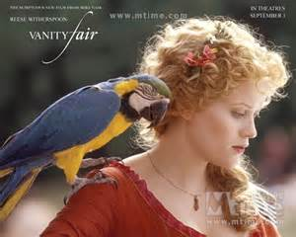

Becky

Slide 61
Becky tries to trap Amelia’s elder brother Joseph into marriage but she fails. She takes a position as governess at Queen’s Crawley. She does her best to ingratiate herself with old Sir Pitt Crawley and his rich sister Miss Crawley, but secretly married to the handsome but weak-minded young captain Rawdon Crawley, second son of Sir Pitt, which angered Miss Crawley who cuts off Rawdon and makes it impossible for him to inherit her money.

Slide 62
During the time of war with France, Rawdon survives the battle and thanks to Becky’s beauty and wit, he earns a lot of money from those naïve soldier-gamblers. When they return to London, Rawdon is imprisoned for debt while Becky is found entertaining Lord Steyne. Rawdon accepts a post abroad and dies of fever there. Becky later goes to live with Joseph who leaves her a sum of money after his death.

Slide 63
While Amelia loves George Osborne. When Mr. Sedley loses most of his money, the old Mr. Osborne, orders his son to break his engagement with Amelia. They get married with the help of Captain Dobbin, who is a secret worshipper of Amelia. When George dies in the war, Amelia lives a life of poverty. Dobbin return from India and confesses his love to Amelia. Amelia is again well-established in society and surrounded by her loving husband and dear son.

Slide 64
“Vanity Fair” is taken from John Bunyan’s “The Pilgrim’s Progress”. All kinds of vanity or goods are being sold, such as “houses, lands, honors, titles, lusts, pleasures, souls, and so on.
Vanity of man is universal and ever present. The world is full of snobbery, duplicity of social-climbers, and the weakness of human nature.

Slide 65
Dickens is regarded as one of the greatest writers. His works were characterized by vivid comic characterization and social criticism. His masterpieces include David Copperfield, Oliver Twist, A Tale of Two Cities and so on.

Slide 66
The 20th Century
William Butler Yeats (1865-1939) | Poems (1906) |  | Nobel prize for Literature
Joseph Conrad (1857-1924) | Lord Jim (1900)
 | Nostromo (1904)
John Galsworthy (1867-1933) | The Forsyte Saga (1906-21)
E. M. Forster (1879-1970) | A Passage to India (1924)
W. Somerset Maugham (1874-1965) | Of Human Bondage (1915)

Slide 67
James Joyce (1882-1941) | Ulysses (1922) |  | Stream of Consciousness
D. H. Lawrence (1885-1930) | Sons and Lovers (1913)
Aldous Huxley (1894-1963)
William Golding (1911-1993) | Lord of the Flies (1954)
Virginia Woolf (1882-1941) | The Waves (1913)
 | To the Lighthouse (1927)

Slide 68
George Bernard Shaw (1856-1950) | Man and Superman (1903), Major Barbara (1905), Pygmalion (1913), Saint Joan (1923) | drama
John Osborne (1929-1994) | Look Back in Anger (1956)

Slide 69
20th Century
The postwar economic dislocation and spiritual disillusion produced a profound impact upon the British people.

Slide 70
Yeats
Yeats was born of an Anglo-Irish Protestant family on June 13, 1865 in Dublin.
His youth was passed during the upsurge of Irish nationalist movement led by Parnell.
Yeats visited Paris in 1894 and was introduced to the Symbolists.
In 1923, he was awarded Nobel prize for literature.

Slide 71
When you are old
When you are old and grey and full of sleep,
And nodding by the fire, take down this book,
And slowly read, and dream of the soft look
Your eyes had once, and of their shadows deep;
How many loved your moments of glad grace,
And loved your beauty with love false or true,
But one man loved the pilgrim Soul in you,
And loved the sorrows of your changing face;
And bending down beside the glowing bars,
Murmur, a little sadly, how Love fled
And paced upon the mountains overhead
And hid his face amid a crowd of stars.叶芝名作When You Are Old 科林 法瑞尔朗读版.flv

Slide 72
When you are old
When you are old and grey and full of sleep,
And nodding by the fire, take down this book,
And slowly read, and dream of the soft look
Your eyes had once, and of their shadows deep;
How many loved your moments of glad grace,
And loved your beauty with love false or true,
But one man loved the pilgrim Soul in you,
And loved the sorrows of your changing face;
And bending down beside the glowing bars,
Murmur, a little sadly, how Love fled
And paced upon the mountains overhead
And hid his face amid a crowd of stars.
当你老了，头白了，睡意昏沉，
炉火旁打盹，请取下这部诗歌，
慢慢读，回想你过去眼神的柔和，
回想它们昔日浓重的阴影；
多少人爱你青春欢畅的时辰，
爱慕你的美丽，假意或真心，
只有一个人爱你那朝圣者的灵魂，
爱你衰老了的脸上痛苦的皱纹；
垂下头来，在红光闪耀的炉子旁，
凄然地轻轻诉说那爱情的消逝，
在头顶的山上它缓缓踱着步子，
在一群星星中间隐藏着脸庞。

Slide 73
James Joyce (1882-1941) is regarded as one of the leading writers of modern times. He was the first to make major use of stream of consciousness, the free flow of language revealing one person’s thoughts, feelings and memories. Ulysses (1922) gives a striking, detailed picture of one day in the lives of Leopold Bloom and Stephen Dedalus.
D. H. Lawrence (1885-1930) felt that society forced too many rules on people and kept them from living a full, natural life. He is one of the greatest English novelists of the 20th century form a working-class family. It is in the novels that his true greatness lies, which include Sons and Lovers, The Rainbow and Women in Love.

Slide 74
Aldous Huxley (1894-1963) experimented with form and criticized society. His two satires are Point Counter Point (1928) and “Brave New World” (1932).

Slide 75
George Bernard Shaw (1856-1950) is the leading English-Language playwright after Shakespeare. His wit and satire have held the stages of the world in such plays as Man and Superman (1903), Major Barbara (1905), Pygmalion (1913) and Saint Joan (1923).

Slide 76
John Osborne (1929-) spoke out for the “angry young men” of England.

